Slide 1
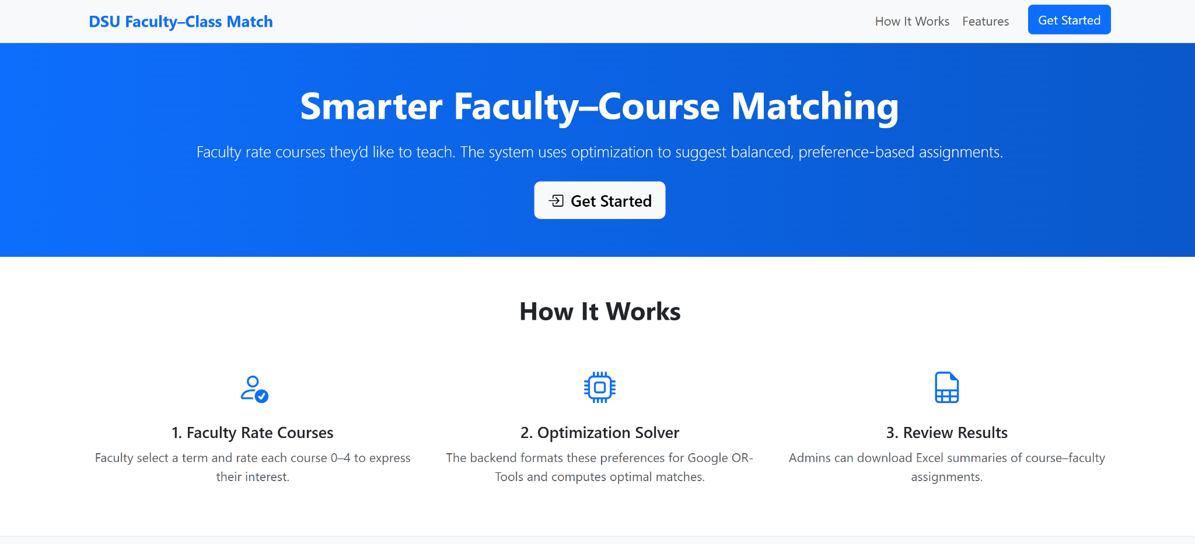
Faculty Match
Notes:
For our project we partnered with Dr. Zwach in a project that had already been started to assign DSU Faculty to courses while finding the best course schedule for all instructors.

Slide 2
The Problem
There is no clear solution to assigning professors to courses.
Notes:
How do college institutions place instructors into courses?
How do they value tenure, years of experience etc.

Slide 3
Proposed Solution
Create a user interface where instructors can input their class preference, as well as their familiarity with the content and desire to teach a course.
This will then find a course schedule for all instructors who have program their preferences.

Slide 4
Implementation
-Pull course data from bim.inclass
-Create a faculty login requirement
-Store Faculty preferences
-Find best schedule
Notes:
This is done by finding the current courses being offered in said semester.
We the ensure that all information is accessible to instructors with a DSU login only.
The instructors then input their class preferences which are then added to a csv file.
The programs algo then finds the best schedule for all of the instructors that have given their input.
The best schedule is then able to be downloaded as an excel file.

Slide 5

Demo

Slide 6
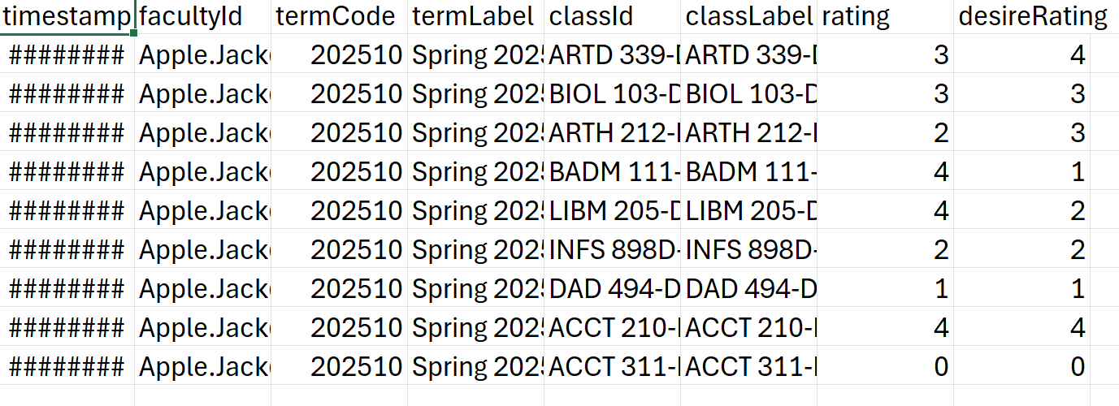
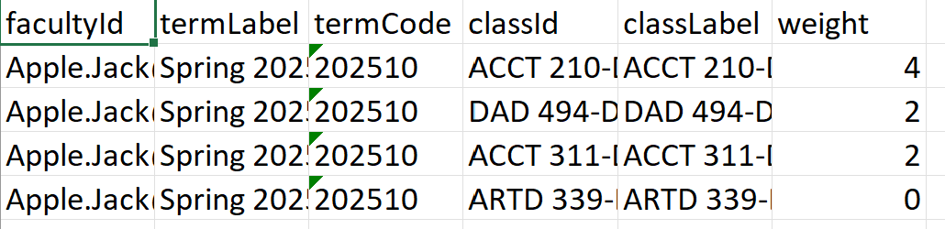
Result
We were able to take the instructors preferences in courses and rank them.
Notes:
We were able to take the input from the instructors and their preferences provided and combine it into a single variable.

Slide 7
Ways to improve
-Add more variables to make the sorting algorithm more comprehensive. Such as adding research interests etc..
-We still need to pull instructors tenure from DSU.
Notes:
These variables that we initially set to determine an instructors placement can also have their weights changed to place stronger importance on tenure, desire etc.

Slide 8
Questions?

